Slide 1
COOKBOOK COMPASS
WEB WEAVERS

Slide 2
TIMOTHY RAMER SAI SREE KORRAPATI POOJA SRI TRIPURANENI ADITYA MALLAKULA
WEB WEAVERS

Slide 3
MENU
Introduction
User Stories
Methodology
System Architecture
Requirements
Future Scope
Conclusion

Slide 4
INTRODUCTION
WEB WEAVERS

Slide 5
INTRODUCTION
What is Cookbook Compass?
An innovative web platform transforming how individuals discover and enjoy cooking recipes.
Designed for both novice cooks and culinary experts.
Ensures finding the perfect recipe is easy and quick through advanced search capabilities and a comprehensive database.
Key Features:
User-Centric Design:
Simple, intuitive navigation to boost user engagement.
Detailed Recipe Information:
Recipes include detailed instructions ingredient lists and preparation times.
User Authentication System:
Secure signup/login for searching recipes.

Slide 6
VALUE PROPOSITION
Beyond Recipes - A Comprehensive Cooking Companion:
Inspires creativity in the kitchen.
Fosters a community of food enthusiasts.
Makes cooking accessible and enjoyable for everyone.
Users discover new cuisines and learn cooking techniques.
Committed to a seamless user experience with an extensive recipe database and robust search functionality.
Cookbook Compass: Your Gateway to Culinary Adventures

Slide 7
USER STORIES
WEB WEAVERS

Slide 8
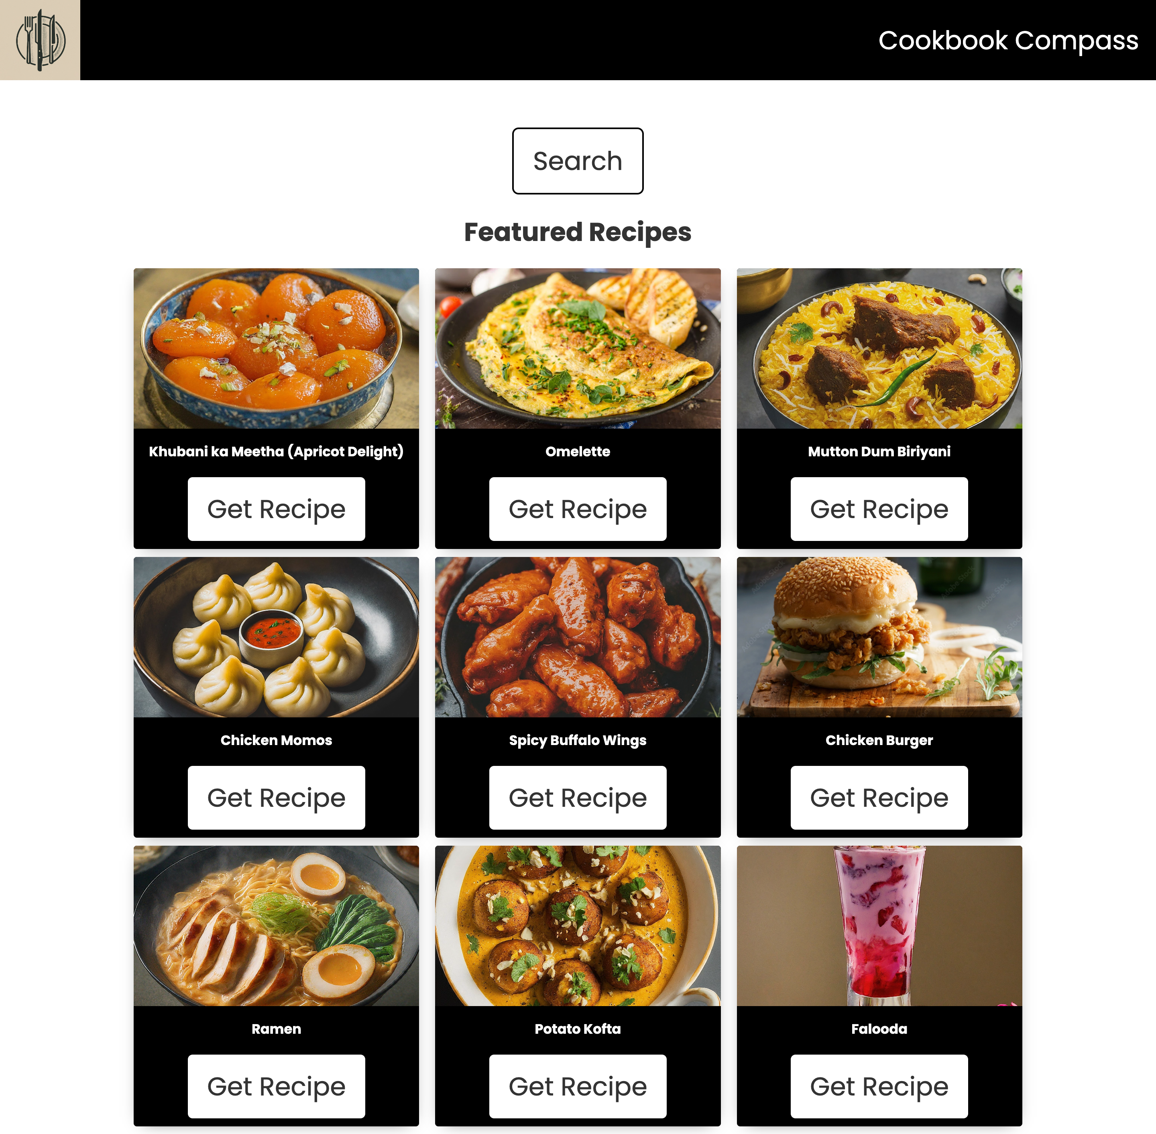
USER STORY – HOME PAGE
Meet Chris: Embarking on a Culinary Journey
First Impressions:
Chris, a culinary enthusiast, is drawn to Cookbook Compass by its promise of unique and delicious recipes.
Featured Recipes Display:
Home page highlights popular recipes, dynamically updated to provide high-quality content.
Chosen based on popularity and user ratings, offering a range from quick dinners to elaborate feasts.

Slide 9
USER STORY – HOME PAGE
Responsive Design:
Built with HTML, CSS, and JavaScript, ensuring a seamless browsing experience on any device.
The layout adapts beautifully, providing an optimal viewing experience on Chris’s laptop, tablet, or smartphone.
Search Functionality:
A prominent search button on the home page invites Chris to begin a personalized recipe discovery journey.
Strategically placed to encourage exploration, leading to new user sign-ups or existing user logins for a customized experience.

Slide 10
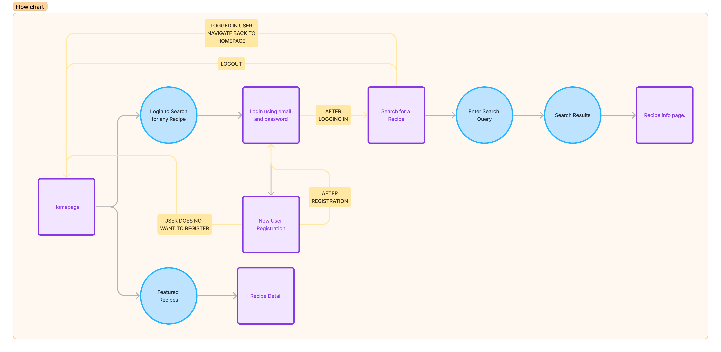
FLOW CHART– HOME PAGE

Slide 11
USER STORY – LOGIN/REGISTRATION
User Story: Alex’s First Venture into Cookbook Compass
Effortless Registration and Login:
Intrigued by diverse recipes, Alex finds the registration simple, with real-time feedback ensuring a smooth process, correcting typos and guiding through secure password creation.
Appreciates swift, secure login and personalized culinary exploration.

Slide 12
USER STORY – LOGIN/REGISTRATION
Intelligent Error Messaging:
Email Validation: Instant error flagging for incorrect email formats, guiding users towards correction.
Password Strength Indicators: Provides dynamic feedback during registration, encouraging secure password choices.
Secure Information Handling:
Utilizes encryption for secure storage of user information, from emails to hashed passwords, protecting privacy and integrity.
User Feedback Loop:
Offers clear, instructive messages throughout the registration and login process, ensuring users are informed about input errors or security requirements.

Slide 13
USER STORY – LOGIN/REGISTRATION
Password Encryption:
User security is a priority; passwords are encrypted with advanced hashing algorithms, ensuring data safety.
Error Handling for Security:
Immediate feedback on entry errors, like incorrect emails, enhances the security of the registration and login processes.
System assesses password strength during registration, advising on stringent security criteria.
A temporary lockout is implemented after several failed login attempts to prevent unauthorized access.

Slide 14
USER STORY – LOGIN/REGISTRATION
User Feedback Mechanisms:
Clear, immediate feedback during registration and login, with helpful error messages and positive confirmation prompts.
Secure Session Management:
Post-login, a secure session allows Alex to navigate Cookbook Compass without repeated logins, with sessions expiring after inactivity for added security.
Security and User Experience: Perfectly Blended
For Alex and all users, Cookbook Compass ensures a balance between secure access and a seamless culinary discovery experience.

Slide 15
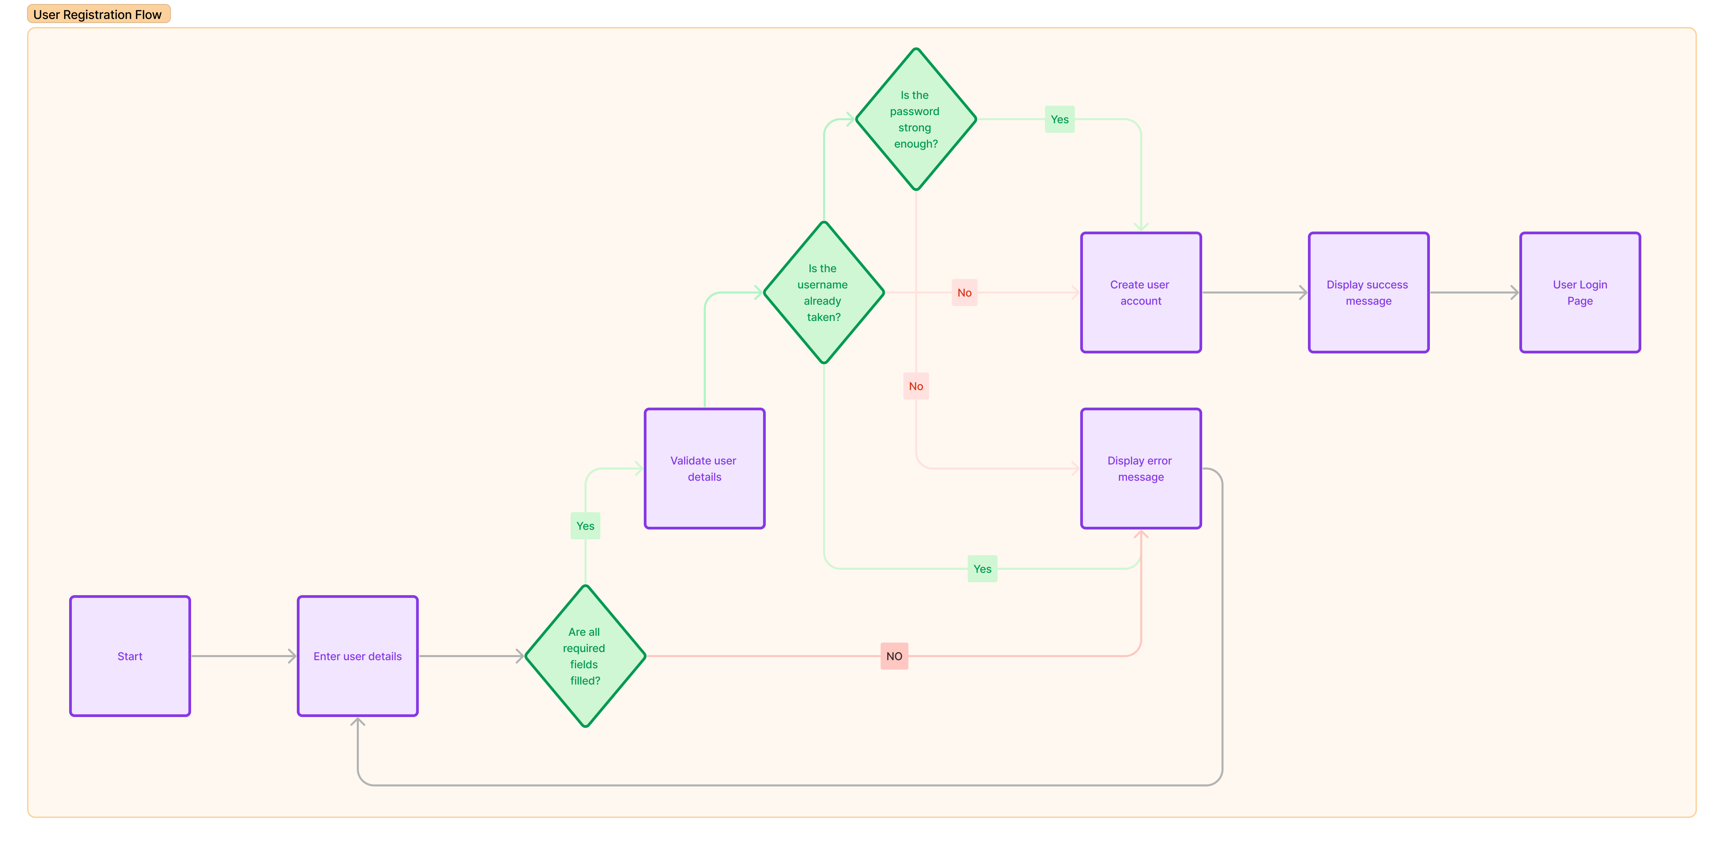
FLOW CHART – LOGIN/REGISTRATION

Slide 16
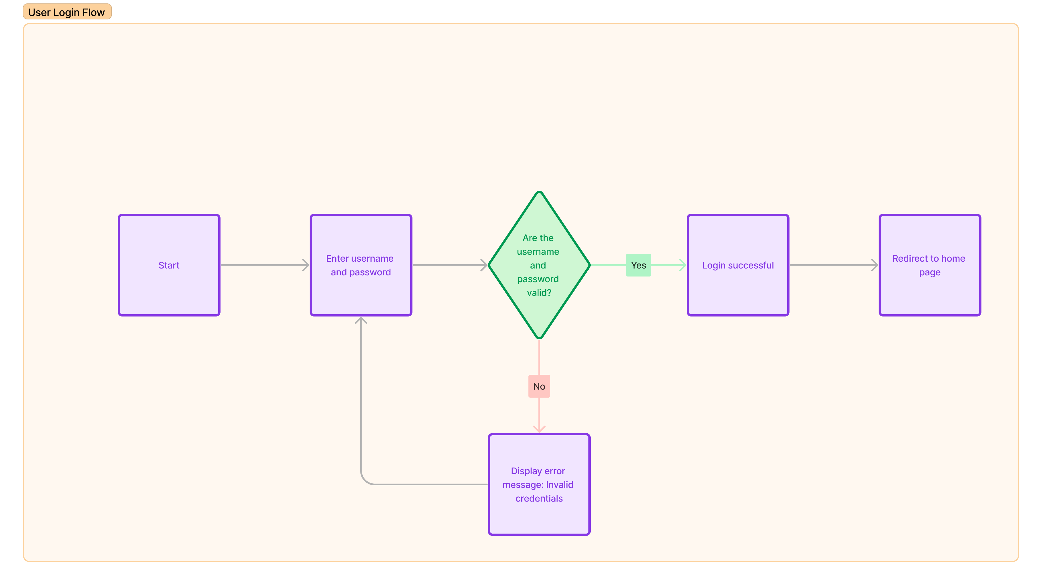
FLOW CHART – LOGIN/REGISTRATION

Slide 17
USER STORY – SEARCH
User Story: Jordan’s Effortless Recipe Search for "Chicken Parmesan"
Quick and Direct Search:
Jordan uses Cookbook Compass to find a "Chicken Parmesan" recipe, appreciating the direct route to the desired recipe, highlighted by a vivid image and step-by-step instructions.

Slide 18
USER STORY – SEARCH
Direct API Search:
Utilizes direct API calls to enable searching by exact recipe names, streamlining searches for specific dishes.
Error Handling:
Handling No Results: Provides a clear message for no-result searches.
Optimized Recipe Displays:
Displays results as recipe cards focusing on essential details for quick, hassle-free access.
API Efficiency:
Dynamic content retrieval through efficient API use, ensuring fast, accurate search results with minimal latency.

Slide 19
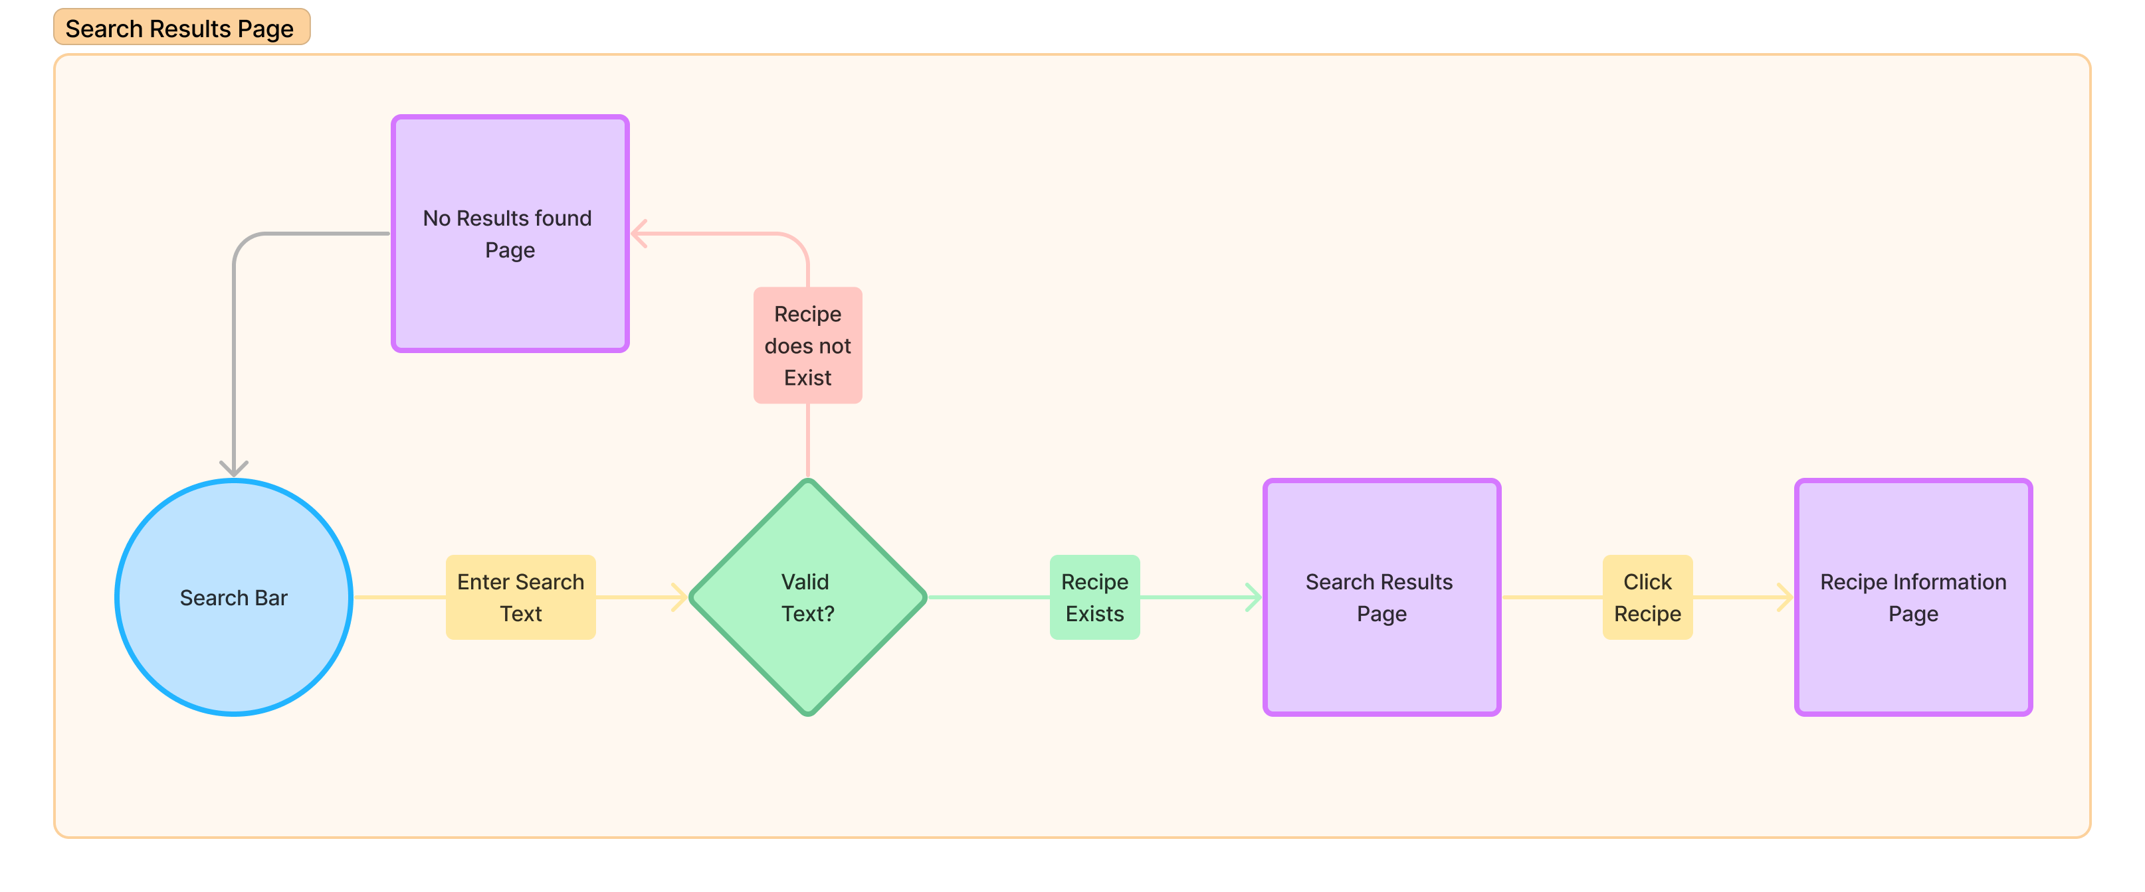
FLOW CHART – SEARCH

Slide 20
USER STORY – RECIPE INFO
User Story: Sam’s Exploration of "Vegetarian Lasagna"
Visual and Informative Guidance:
Sam discovers the “Vegetarian Lasagna” recipe, captivated by vibrant, high-resolution images and an intuitive layout that enhances the cooking journey.
The Recipe Information Page showcases a comprehensive ingredients list and organized cooking instructions for a seamless experience.

Slide 21
USER STORY – RECIPE INFO
Ingredient Transparency:
Detailed ingredients list with quantities and preparation notes, enabling easy pre-cooking preparation.
Step-by-Step Guidance:
Cooking instructions laid out in a clear, sequential format; concise yet descriptive to suit all skill levels.
Optional Visual Aids:
High-definition images and optional video tutorials offer a multi-sensory learning experience, making complex steps understandable.
Responsive Design:
The Recipe Information Page is optimized for all web browsers on desktops for pre-cooking study.

Slide 22
METHODOLOGY
WEB WEAVERS

Slide 23
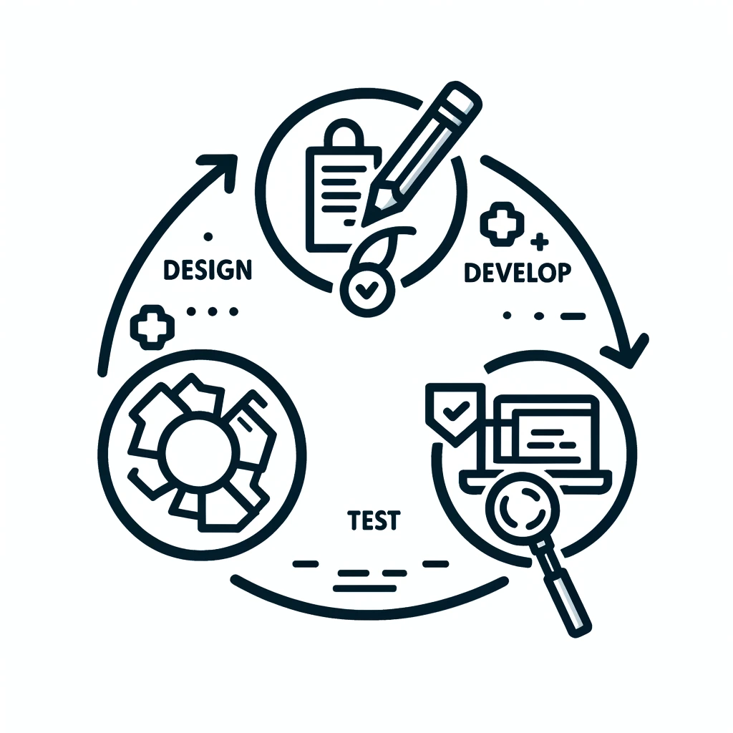
METHODOLOGY
Agile Kitchen: Cooking Up a Storm
Agile Methodology Adoption:
Development likened to preparing a complex dish, with sprints as cooking sessions.
Features developed and tested iteratively to meet user expectations.

Slide 24
METHODOLOGY
Initial Stages (Sprints 1 & 2):
Focus on design, mockups, and user stories for essential pages (Homepage, Login/Registration).
Rapid prototyping and user feedback drive early iterations, emphasizing core functionalities and backend integration.
Mid-Project Evolution (Sprints 3 & 4):
Enhanced search functionalities and UI/UX refinements based on user feedback.
Optimization phase critical for preparing a functional and appealing MVP.
Final Push (Sprint 5):
Dedicated to exhaustive testing, deployment, and performance monitoring.
Ensured the platform was polished, user-friendly, and launch-ready, with ongoing assessments for future enhancements.

Slide 25
SYSTEM ARCHITECTURE
WEB WEAVERS

Slide 26
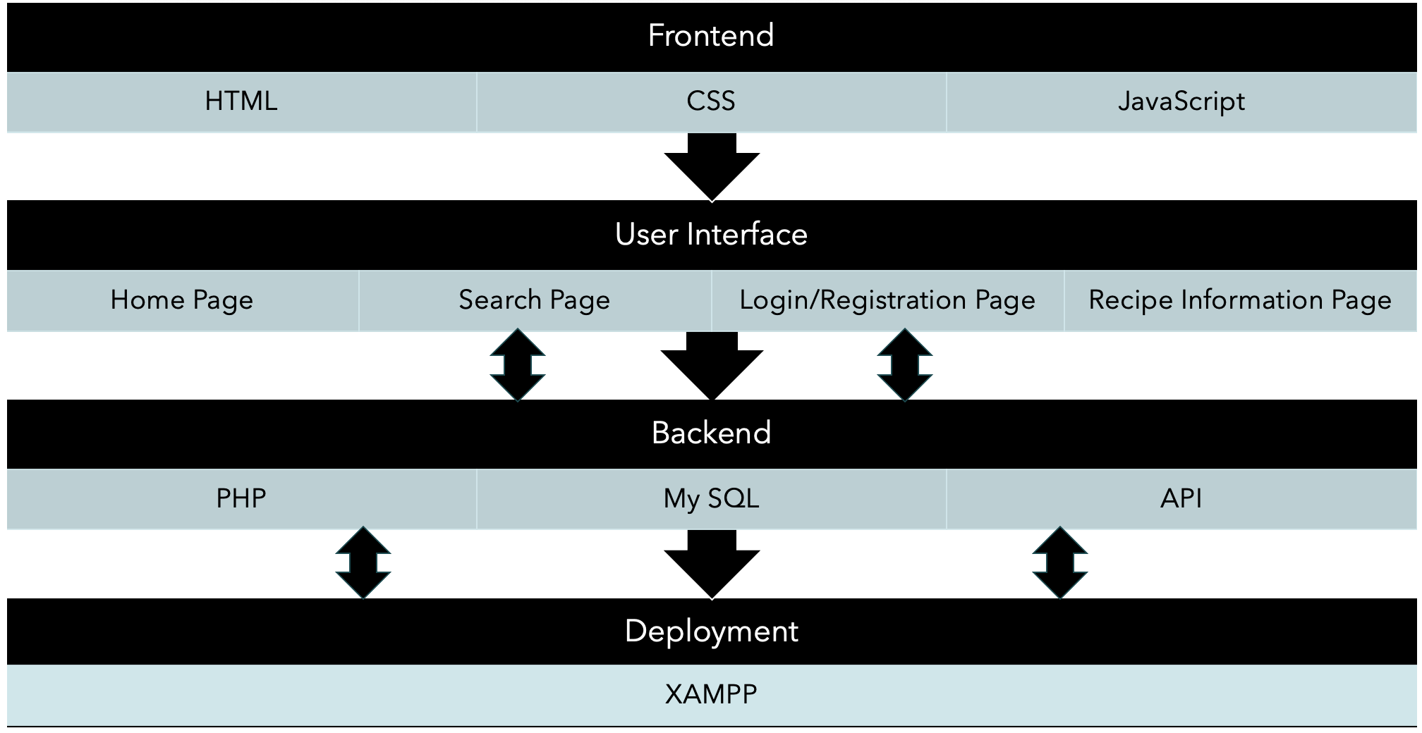
SYSTEM ARCHITECTURE

Slide 27
FRONTEND
Frontend Development:
Technologies: HTML, CSS, JavaScript (ES6+)
Functionality in Cookbook Compass:
Frontend combines HTML, CSS, and JavaScript for structure, style, and interactivity, respectively.
Ensures accessibility and responsiveness for a seamless experience across all devices.
Dynamic interactivity enabled through JavaScript for user inputs, form submissions, and content loading.
Delivers an engaging and intuitive user experience, making the website accessible and enjoyable for everyone.

Slide 28
BACKEND
Backend Processing with PHP:
Technology: PHP
Functionality in Cookbook Compass:
PHP is utilized for critical user authentication and data validation tasks.
Validates login and registration information against MySQL database entries.
Manages secure user sessions and form submissions for registration and login.
Implements encryption for user passwords before storing in the database.
Ensures a secure and reliable user authentication process.

Slide 29
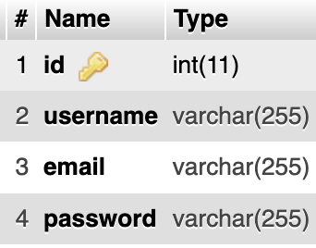
DATABASE
Database Management with MySQL:
System: MySQL
Functionality in Cookbook Compass:
MySQL database stores user registration details: usernames, hashed passwords, email addresses.
Acts as a secure repository for PHP backend to authenticate users and register new ones.
Structured database ensures efficient data retrieval and storage.
Safeguards user credentials through secure management practices.
Facilitates a reliable and swift user authentication and registration process.

Slide 30
API INTEGRATION
API Integration:
Role: Extends the website's functionality
Functionality in Cookbook Compass:
PHP and MySQL focus on user functionalities, while external APIs manage recipe data.
APIs provide ingredients, instructions, and images for a wide range of recipes.
Integration allows access to a vast recipe selection without local database storage.
Enhances the platform's content variety and user experience by leveraging external resources.
Streamlines recipe content updates and maintenance through API connections.

Slide 31
LOCAL HOSTING
Local System Hosting:
Environment: Development and testing phase
Functionality in Cookbook Compass:
Local hosting with tools like XAMPP supports development and testing of Cookbook Compass.
Simulates a live server environment for accurate feature development and testing.
Enables pre-live debugging and functionality testing in a controlled setting.
Enhances the reliability and performance of the website before it goes live.
Streamlines the transition from development to live deployment.

Slide 32
REQUIREMENTS
WEB WEAVERS

Slide 33
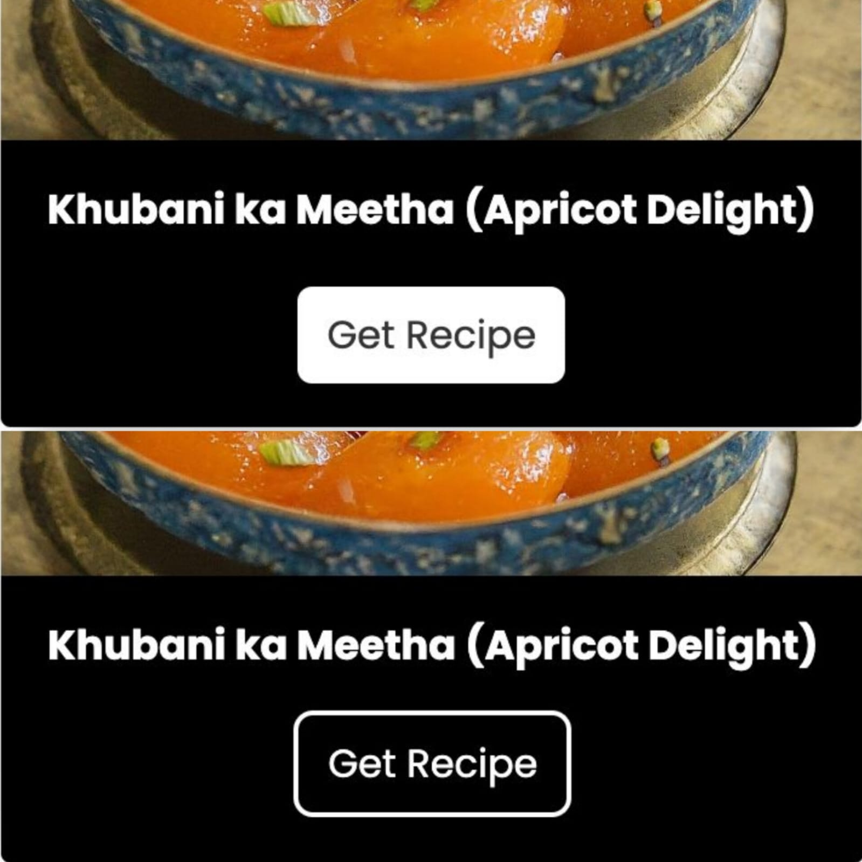
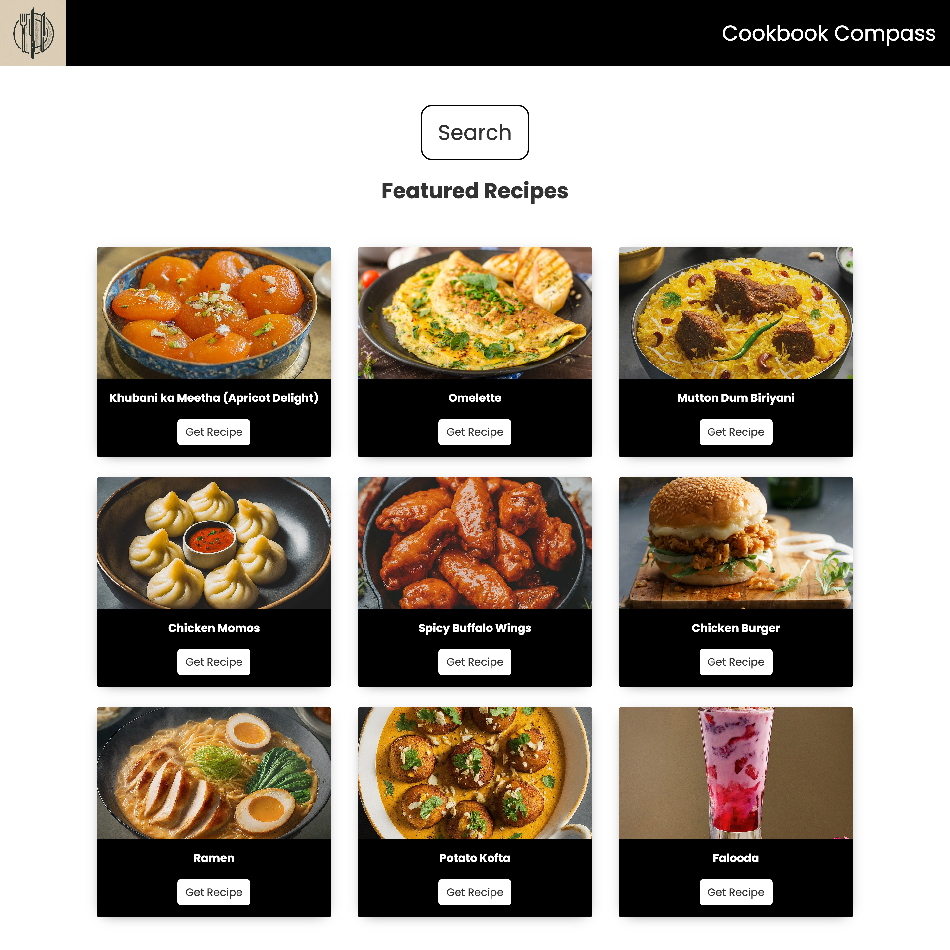
USER EXPERIENCE AND DESIGN
Requirements Addressed:
Responsive design for seamless experience across devices.
Image embedding, including thumbnails that correspond to full-sized images with captions.
Featured recipes on the Home Page to attract users.
Design Integration & Technical Solutions:
Responsive Design: Utilizes CSS media queries and flexible grid layouts, ensuring accessibility and a positive user experience across a range of devices.
Image Handling: Embeds thumbnails with HTML and CSS for interactivity, expanding to full-sized images upon user interaction, enriching the site's visual appeal.

Slide 34
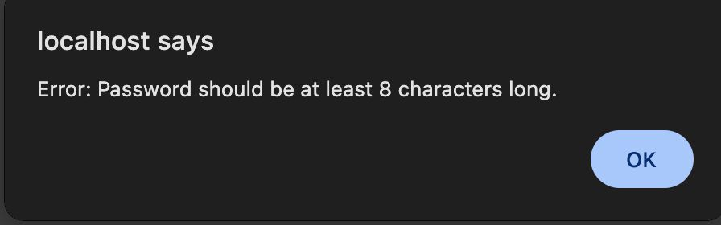
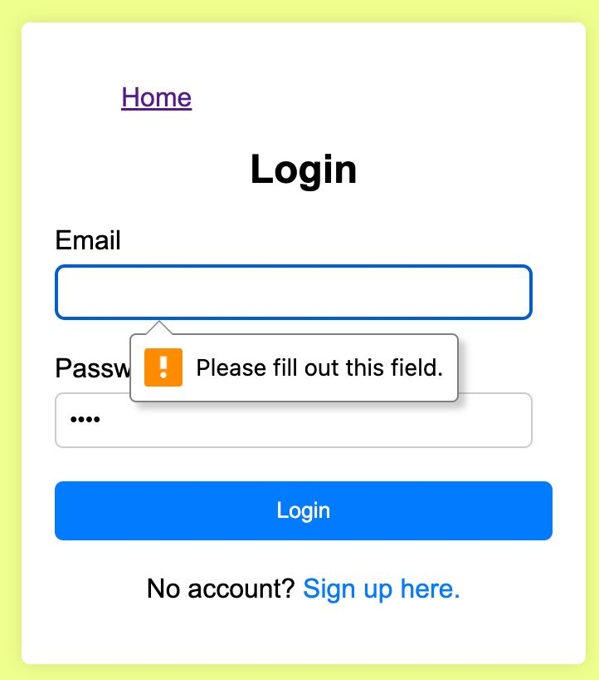
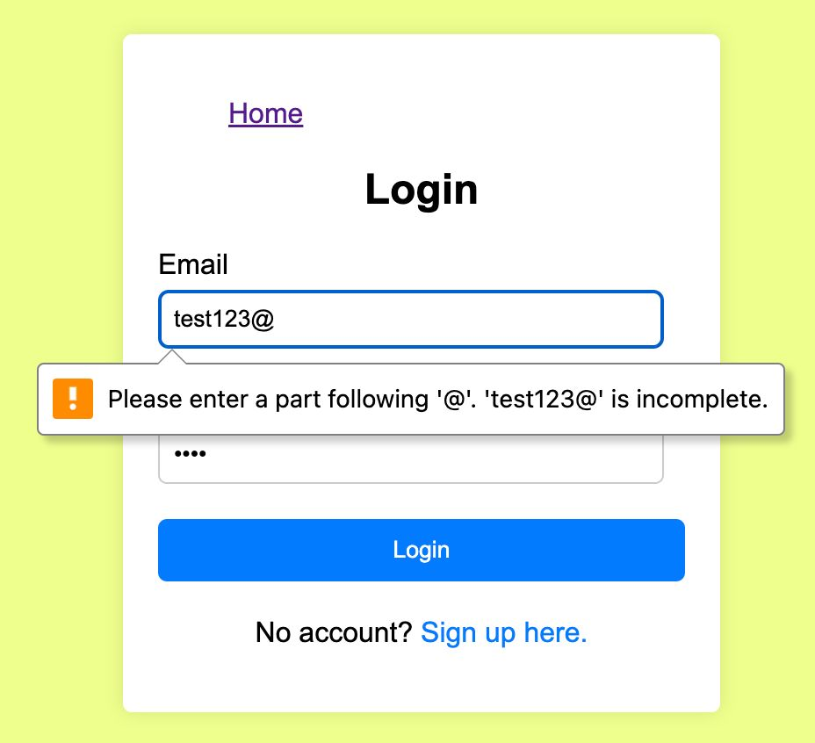
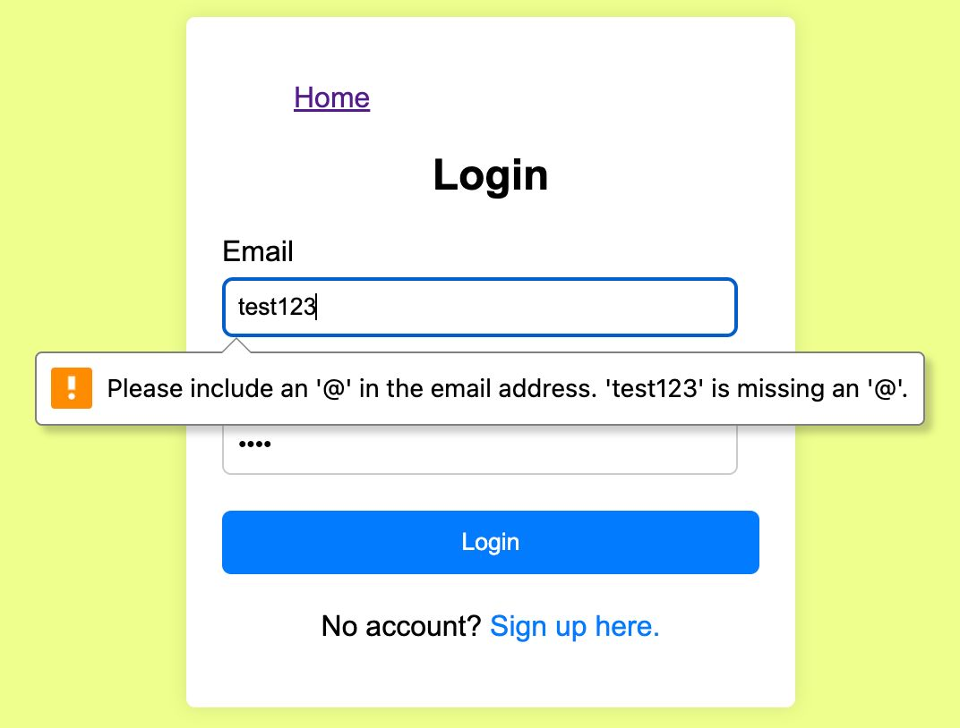
USER REGISTRATION AND LOGIN
Requirements Addressed:
Secure user registration and login process.
Encrypted password storage.
Form validation with immediate error messaging for incorrect email formats or passwords.
Ensuring all required fields are filled before submission.
Design Integration & Technical Solutions:
Security Measures: Leverages PHP for backend validation, encrypting passwords before storage in MySQL, and JavaScript for front-end validation, enhancing site security and user trust.

Slide 35
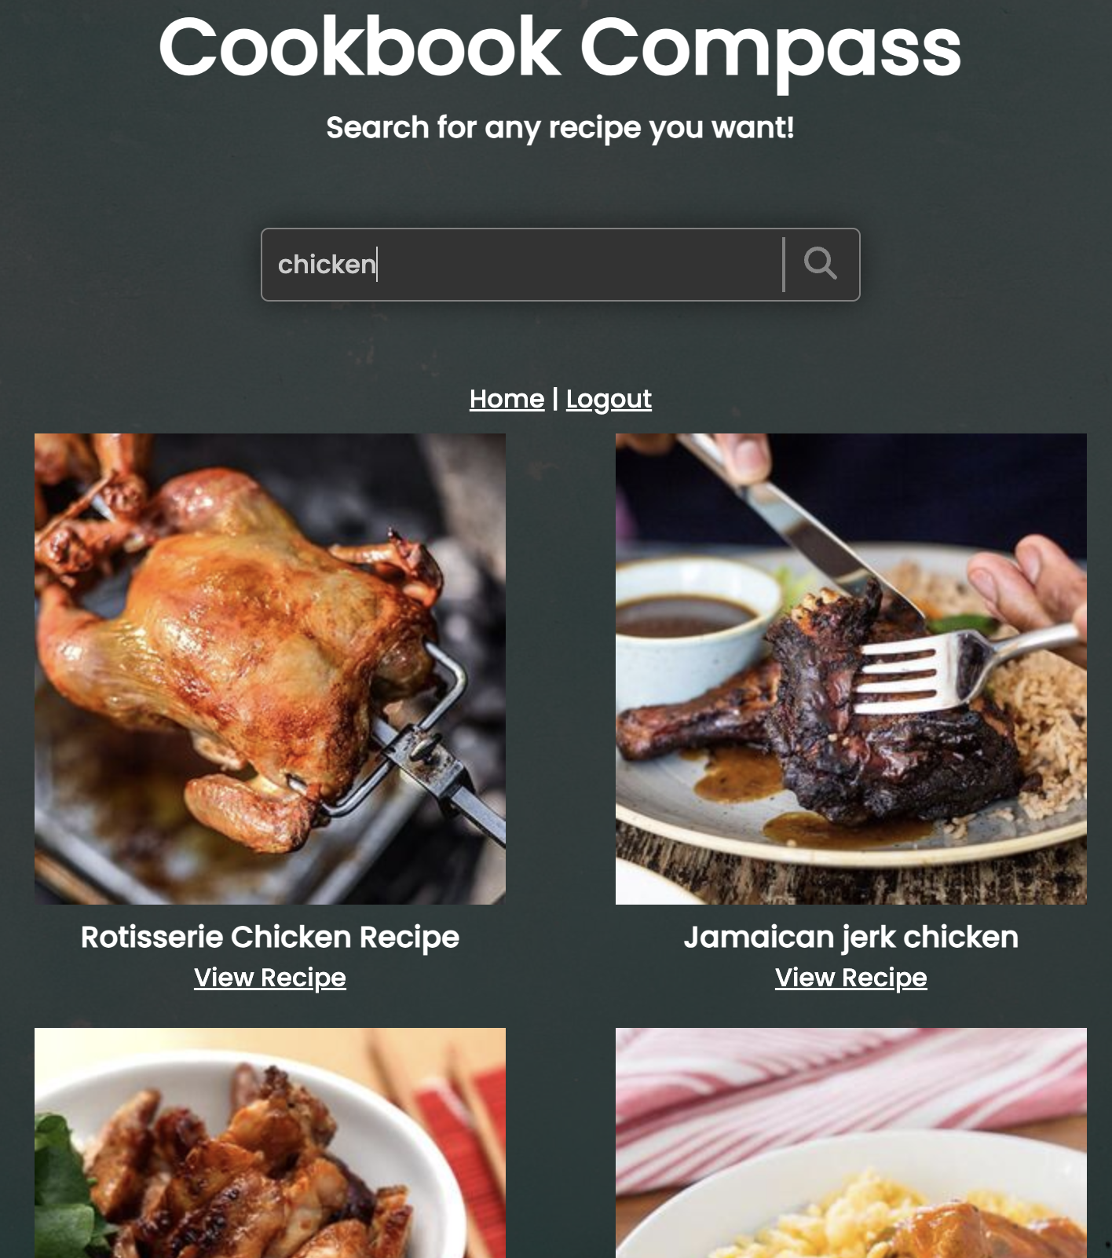
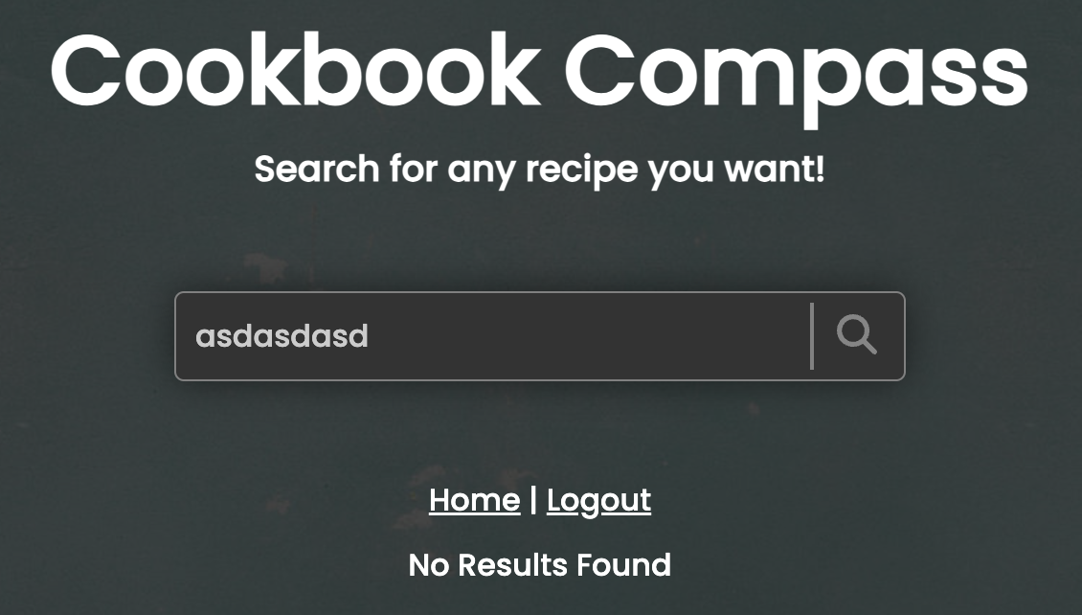
CONTENT SEARCH
Requirements Addressed:
Efficient search functionality for recipes.
Grid/list display of search results with detailed recipe cards.
Displaying a "No Results Found" message for unsuccessful searches.
Intuitive navigation from the Home Page to the Search Results Page upon login.
Design Integration & Technical Solutions:
Search Functionality: Implements JavaScript for dynamic search experiences, and HTML/CSS for aesthetically presenting results, offering an engaging user journey. It also displays a message in case the search query cannot be retrieved.
Recipes Around the Globe: Uses API based searching for retrieving any recipe across different cultures.

Slide 36
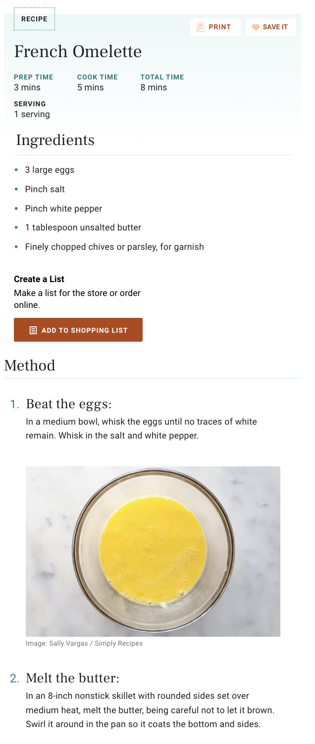
RECIPE INFORMATION
Requirements Addressed:
Detailed recipe pages with images, ingredients, and step-by-step instructions.
Optional to include video tutorials for recipes.
Design Integration & Technical Solutions:
Third-party webpages are opened on clicking the search results. They contain all the information required to prepare the dish.
These webpages are designed using their own set of technologies.

Slide 37
LIVE DEMO
WEB WEAVERS

Slide 38
FUTURE SCOPE
WEB WEAVERS

Slide 39
FUTURE SCOPE
Fix Backlogged issues:
There are a few minor issues that do not affect the core functionality of the application. They need to be fixed in the next sprint.
UI/UX Improvements:
The webpage appear too bland. Beautify to attract more users.
Monetary Element:
Pay for special recipes and search access.
Social Improvements:
Like, share, subscribe to recipes
Recipe Submission:
Ability to submit your own recipes

Slide 40
CONCLUSION
WEB WEAVERS

Slide 41
CONCLUSION
Created a project from scratch:
Built a recipe search website with login functionality from ground up.
Learnt and implemented new technologies:
Learnt basics of HTML, CSS, Java script, PHP, MySQL.
Implemented what we learnt as part of the project.
Worked as part of a team to engineer software:
Collaborated as a team of 4.
Regular meetings & dividing tasks.
Software Engineering:
Developed an application from start to finish.
Implemented software development approaches learnt during the course.

Slide 42
ANY QUESTIONS?
WEB WEAVERS

Slide 43
THE END
WEB WEAVERS

